Slide 1
You Can’t Handle the Error!
Getting more out of your SqlException
Dan Harrigan
Senior Software Engineer
Strategic Marketing
dan.harrigan@yahoo.com

Slide 2


Slide 3
About Me
Started development with databases in 1994
BS in Engineering
Materials/thermal engineer
Masters in Education
Taught HS Math and Computer Science
Hit the reset button…traveled some…
Business Applications since 2007

Slide 4
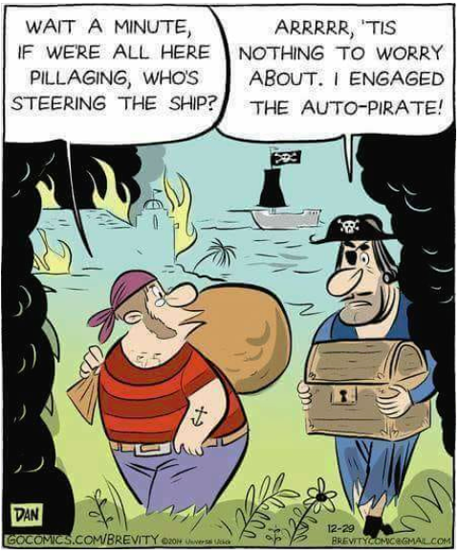

Slide 5
Today’s Targets…
SQL Server Stuff
RAISERROR vs. ;THROW
TRY / CATCH
TRANSACTION
Demos (SQL and C#)
Strategies
Be proactive
Log accordingly
Keep the user in the loop

Slide 6
RAISERROR vs. ;THROW

Slide 7
Triggering Errors in SQL Server
RAISERROR ( { msg_id | msg_str | @local_variable }
{ ,severity ,state }
[ ,argument [ ,...n ] ] )
[ WITH option [ ,...n ] ]
https://docs.microsoft.com/en-us/sql/t-sql/language-elements/raiserror-transact-sql

Slide 8
Triggering Errors in SQL Server
RAISERROR ( { msg_id | msg_str | @local_variable }
{ ,severity ,state }
[ ,argument [ ,...n ] ] )
[ WITH option [ ,...n ] ]
msg_str is a string of characters with optional embedded conversion specifications.
Each conversion specification defines how a value in the argument list is formatted and placed into a field at the location of the conversion specification.

Slide 9
Triggering Errors in SQL Server
RAISERROR ( { msg_id | msg_str | @local_variable }
{ ,severity ,state }
[ ,argument [ ,...n ] ] )
[ WITH option [ ,...n ] ]
severity is the user-defined severity level associated with this message.
Severity levels from 0 to 18 can be specified by any user. Severity levels from 19 to 25 require special role permissions, like the sysadmin role.
Can be used to filter errors that are returned to the calling application.

Slide 10
Triggering Errors in SQL Server
RAISERROR ( { msg_id | msg_str | @local_variable }
{ ,severity ,state }
[ ,argument [ ,...n ] ] )
[ WITH option [ ,...n ] ]
state is an integer from 0 to 255.
Can be used to debug errors by using unique state values throughout the stored procedure.
Can also be used to filter errors that are returned to the calling application.

Slide 11
Triggering Errors in SQL Server
RAISERROR ( { msg_id | msg_str | @local_variable }
{ ,severity ,state }
[ ,argument [ ,...n ] ] )
[ WITH option [ ,...n ] ]
argument is the list of parameters used in the substitution for variables defined in the message string.
There can be ZERO to 20 substitution parameters.
Can be a local variable or TINYINT, SMALLINT, INT, CHAR, VARCHAR, NCHAR, NVARCHAR, BINARY, NBINARY.

Slide 12
Triggering Errors in SQL Server
THROW [ { error_number | @local_variable },
{ message | @local_variable },
{ state | @local_variable } ]
[ ; ]
https://docs.microsoft.com/en-us/sql/t-sql/language-elements/throw-transact-sql

Slide 13
Triggering Errors in SQL Server
THROW [ { error_number | @local_variable },
{ message | @local_variable },
{ state | @local_variable } ]
[ ; ]
message – does not take conversion specifications like in RAISERROR
state – same as RAISERROR
No severity ? ? ?
…it will always be 16.

Slide 14
TRY/CATCH

Slide 15
BEGIN TRY
...
END TRY
BEGIN CATCH
...
END CATCH
https://docs.microsoft.com/en-us/sql/t-sql/language-elements/try-catch-transact-sql

Slide 16
TRANSACTION

Slide 17
BEGIN TRANSACTION
BEGIN TRY
...
...
...
COMMIT TRANSACTION
END TRY
BEGIN CATCH
ROLLBACK TRANSACTION
...
END CATCH
https://docs.microsoft.com/en-us/sql/t-sql/language-elements/transactions-transact-sql

Slide 18
Stop! Demo time…

Slide 19
Transaction Isolation Levels & Reads
Isolation Level | Dirty Reads | Lost Update | Nonrepeatable Reads | Phantom Reads
Read Uncommitted | Yes | Yes | Yes | Yes
Read Committed | No | Yes | Yes | Yes
Repeatable Read | No | No | No | Yes
Serializable | No | No | No | No
Snapshot | No | No | No | No

Slide 20
Some “Better” Practices…
Be proactive

Slide 21
Error ID10T
Validate SQL parameters and give the user friendly feedback.
Unwelcomed NULL values
Column constraints
Foreign keys
Invalid type casts
And more…

Slide 22
Log accordingly

Slide 23
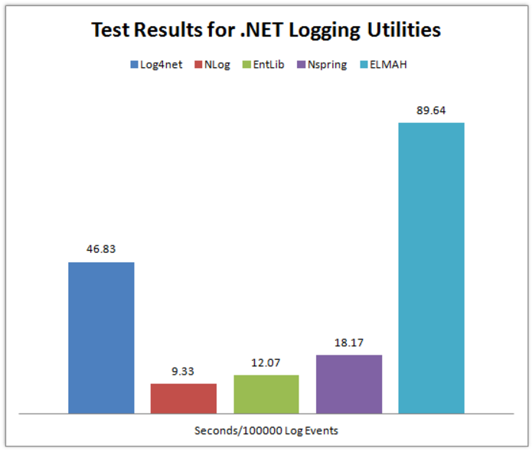
Use a logging library
Don’t reinvent the wheel.
https://www.loggly.com/blog/benchmarking-5-popular-net-logging-libraries/

Slide 24
Use appropriate logging levels
Level | Example
Fatal | Highest level: important stuff down
Error | For example application crashes / exceptions.
Warn | Incorrect behavior but the application can continue
Info | Normal behavior like mail sent, user updated profile, etc.
Debug | Executed queries, user authenticated, session expired
Trace | Begin method X, end method X, etc.
Stop using Console.WriteLine() and use your logger. Configure your logger to write to your Output window when running locally.
In production, you can have the logger send a group email when an ERROR+ is logged.
https://github.com/NLog/NLog/wiki/Configuration-file#log-levels

Slide 25
ILogger _logger;
string someImportantString = "Look at me!";
int someImportantNumber = 42;
// DO do this
_logger.Debug("String is {0} and number is {1}.",
someImportantString, someImportantNumber);
// DO NOT do this
_logger.Debug("String is " + someImportantString + " and " +
"number is " + someImportantNumber + ".");
// or this
_logger.Debug(String.Format("String is {0} and number is {1}.",
someImportantString, someImportantNumber));
// or this
_logger.Debug($"String is {someImportantString} and " +
$"number is {someImportantNumber}.");

Slide 26
Keep the user in the loop

Slide 27
No Black Magic!
If you are doing a change behind the scenes that is a result of the user’s action, let them know in the form of informative text.
If there is an error, let the user know with a generic message (log the details for the development team).
If a message is meant to inform the user, make it friendly (again, log the details).

Slide 28

Thank you!
Questions, do you have?

Slide 29
You Can’t Handle the Error!
Getting more out of your SqlException
Dan Harrigan
Senior Software Engineer
Strategic Marketing
dan.harrigan@yahoo.com
https://github.com/dannyrobe/sql-exception-cp2018.git

